Slide 1
CS2005 Database Systems
Fall 2022
National University of Computer and Emerging Sciences

Slide 2
CHAPTER 7
More SQL: Complex Queries, Triggers, Views, and Schema Modification

Slide 3
More Complex SQL Retrieval Queries
Because of the generality and expressive power of the language, there are many additional features that allow users to specify more complex retrievals from the database:
Nested queries, joined tables, and outer joins (in the FROM clause), aggregate functions, and grouping

Slide 4
Comparisons Involving NULL and Three-Valued Logic
Meanings of NULL
Unknown Value
Unavailable or withheld value
Not applicable attribute
Each individual NULL value considered to be different from every other NULL value
SQL uses a three-valued logic:
TRUE, FALSE, and UNKNOWN (like Maybe)
NULL = NULL comparison is avoided

Slide 5
When a record with NULL in one of its attributes is involved in a comparison operation, the result is considered to be UNKNOWN (it may be TRUE or it may be FALSE)

Slide 6
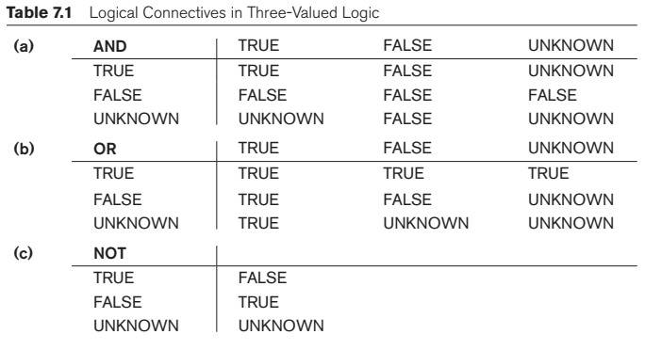
Comparisons Involving NULL and Three-Valued Logic (cont’d.)
Notes:
When a record with NULL in one of its attributes is involved in a comparison operation, the result is considered to be UNKNOWN (It may be TRU or it may be FALSE)

Slide 7

Comparisons Involving NULL and Three-Valued Logic (cont’d.)
SQL allows queries that check whether an attribute value is NULL
IS or IS NOT NULL

Slide 8
Nested Queries, Tuples, and Set/Multiset Comparisons
Nested queries
Complete select-from-where blocks within WHERE clause of another query
Outer query and nested subqueries
Comparison operator IN
Compares value v with a set (or multiset) of values V
Evaluates to TRUE if v is one of the elements in V

Slide 9
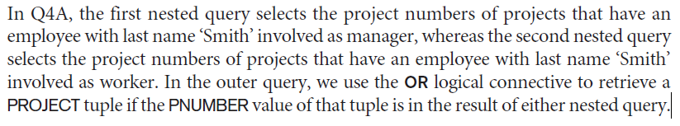
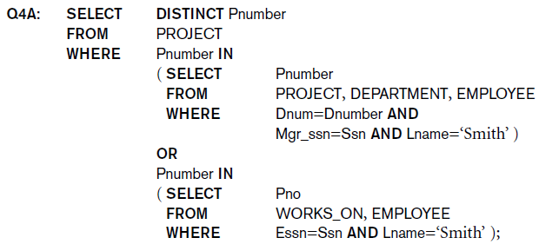
Nested Queries (cont’d.)

Slide 10
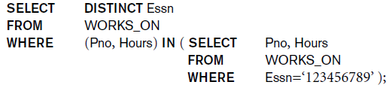
Nested Queries (cont’d.)
Use tuples of values in comparisons
Place them within parentheses

Slide 11
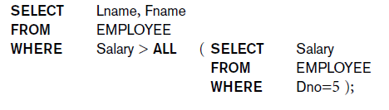
Nested Queries (cont’d.)
Use other comparison operators to compare a single value v
= ANY (or = SOME) operator
Returns TRUE if the value v is equal to some value in the set V and is hence equivalent to IN
Other operators that can be combined with ANY (or SOME): >, >=, <, <=, and <>
ALL: value must exceed all values from nested query

Slide 12
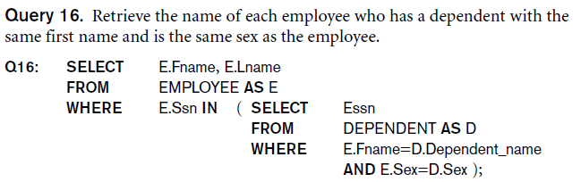
Nested Queries (cont’d.)
Avoid potential errors and ambiguities
Create tuple variables (aliases) for all tables referenced in SQL query

Slide 13
Correlated Nested Queries
Queries that are nested using the = or IN comparison operator can be collapsed into one single block: E.g., Q16 can be written as:
SELECT E.Fname, E.Lname
FROM EMPLOYEE AS E, DEPENDENT AS D
WHERE E.Ssn=D.Essn AND E.Sex=D.Sex AND E.Fname=D.Dependent_name;
Correlated nested query
Evaluated once for each tuple in the outer query
Notes:
In general, a query written with nested select-from-where blocks and using the = or IN comparison operators can always be expressed as a single block query. For example, Q16 may be written as in Q16A:

Slide 14

Explicit Sets and Renaming of Attributes in SQL
Can use explicit set of values in WHERE clause
Q17: SELECT DISTINCT Essn
FROM WORKS_ON
WHERE Pno IN (1, 2, 3);
Use qualifier AS followed by desired new name
Rename any attribute that appears in the result of a query

Slide 15
The SQL EXCEPT clause/operator is used to combine two SELECT statements and returns rows from the first SELECT statement that are not returned by the second SELECT statement

Slide 16

Specifying Joined Tables in the FROM Clause of SQL
Joined table
Permits users to specify a table resulting from a join operation in the FROM clause of a query
The FROM clause in Q1A
Contains a single joined table. JOIN may also be called INNER JOIN

Slide 17
Different Types of JOINed Tables in SQL
Specify different types of join
NATURAL JOIN
Various types of OUTER JOIN (LEFT, RIGHT, FULL )
NATURAL JOIN on two relations R and S
No join condition specified
Is equivalent to an implicit EQUIJOIN condition for each pair of attributes with same name from R and S

Slide 18
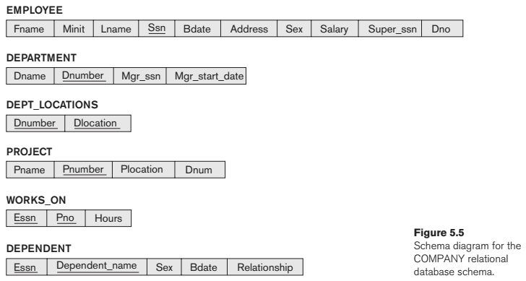

Slide 19
NATURAL JOIN
Rename attributes of one relation so it can be joined with another using NATURAL JOIN:
Q1B: SELECT Fname, Lname, Address
FROM (EMPLOYEE NATURAL JOIN (DEPARTMENT AS DEPT (Dname, Dno, Mssn, Msdate)))
WHERE Dname=‘Research’;
The above works with EMPLOYEE.Dno = DEPT.Dno as an implicit join condition

Slide 20
INNER and OUTER Joins
INNER JOIN (versus OUTER JOIN)
Default type of join in a joined table
Tuple is included in the result only if a matching tuple exists in the other relation
LEFT OUTER JOIN
Every tuple in left table must appear in result
If no matching tuple
Padded with NULL values for attributes of right table
RIGHT OUTER JOIN
Every tuple in right table must appear in result
If no matching tuple
Padded with NULL values for attributes of left table

Slide 21
The major difference between inner and outer joins is that inner joins result in the intersection of two tables, whereas outer joins result in the union of two tables.
Left and right outer joins are useful if you want to get all the values from one table but only the rows that match that table from the other table.

Slide 22
Example: LEFT OUTER JOIN
SELECT E.Lname AS Employee_Name
S.Lname AS Supervisor_Name
FROM Employee AS E LEFT OUTER JOIN EMPLOYEE AS S ON E.Super_ssn = S.Ssn)
ALTERNATE SYNTAX:
SELECT E.Lname , S.Lname
FROM EMPLOYEE E, EMPLOYEE S
WHERE E.Super_ssn + = S.Ssn

Slide 23
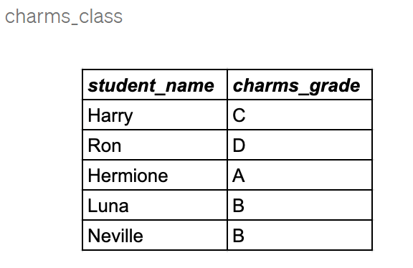
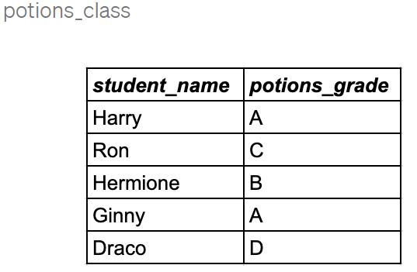

Slide 24
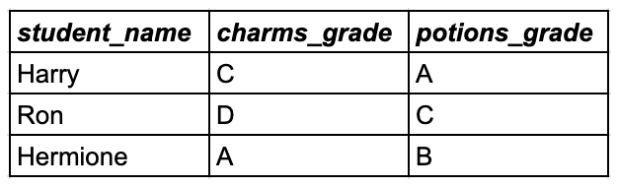
SELECT * FROM charms_class INNER JOIN potions_class on charms_class.student_name = potions_class.student_name;

Slide 25
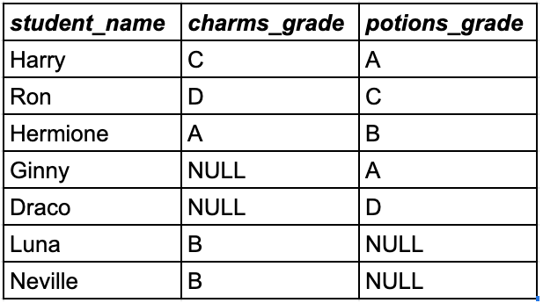
select * from charms_class FULL OUTER JOIN potions_class on charms_class.student_name=potions_class.student_name;

Slide 26
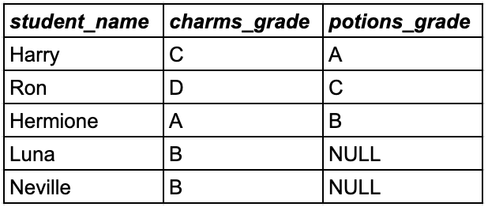
select * from charms_class LEFT OUTER JOIN potions_class on charms_class.student_name=potions_class.student_name;

Slide 27
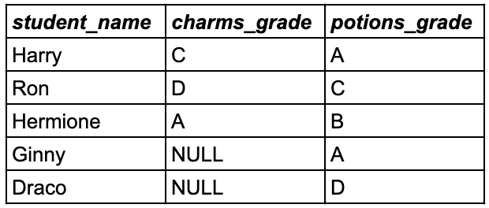
select * from charms_class RIGHT OUTER JOIN potions_class on charms_class.student_name=potions_class.student_name;

Slide 28
Multiway JOIN in the FROM clause
FULL OUTER JOIN – combines result if LEFT and RIGHT OUTER JOIN
Can nest JOIN specifications for a multiway join:
Q2A: SELECT Pnumber, Dnum, Lname, Address, Bdate
FROM ((PROJECT JOIN DEPARTMENT ON Dnum=Dnumber) JOIN EMPLOYEE ON Mgr_ssn=Ssn)
WHERE Plocation=‘Stafford’;

Slide 29
Aggregate Functions in SQL
Used to summarize information from multiple tuples into a single-tuple summary
Built-in aggregate functions
COUNT, SUM, MAX, MIN, and AVG
Grouping
Create subgroups of tuples before summarizing
To select entire groups, HAVING clause is used
Aggregate functions can be used in the SELECT clause or in a HAVING clause

Slide 30
Renaming Results of Aggregation
Following query returns a single row of computed values from EMPLOYEE table:
Q19: SELECT SUM (Salary), MAX (Salary), MIN (Salary), AVG (Salary)
FROM EMPLOYEE;
The result can be presented with new names:
Q19A: SELECT SUM (Salary) AS Total_Sal, MAX (Salary) AS Highest_Sal, MIN (Salary) AS Lowest_Sal, AVG (Salary) AS Average_Sal
FROM EMPLOYEE;

Slide 31
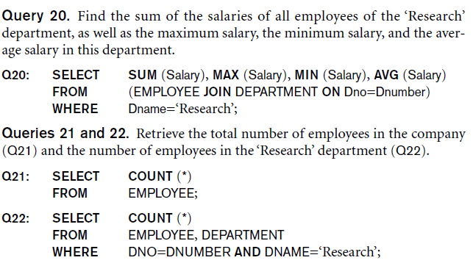
Aggregate Functions in SQL (cont’d.)
NULL values are discarded when aggregate functions are applied to a particular column

Slide 32
Aggregate Functions on Booleans
SOME and ALL may be applied as functions on Boolean Values.
SOME returns true if at least one element in the collection is TRUE (similar to OR)
ALL returns true if all of the elements in the collection are TRUE (similar to AND)

Slide 33
Grouping: The GROUP BY Clause
The SQL GROUP BY clause is used in collaboration with the SELECT statement to arrange identical data into groups.
This GROUP BY clause follows the WHERE clause in a SELECT statement and precedes the ORDER BY clause
Partition relation into subsets of tuples
Based on grouping attribute(s)
Apply function to each such group independently
GROUP BY clause
Specifies grouping attributes
COUNT (*) counts the number of rows in the group

Slide 34
Examples of GROUP BY
The grouping attribute must appear in the SELECT clause:
Q24: SELECT Dno, COUNT (*), AVG (Salary)
FROM EMPLOYEE
GROUP BY Dno;
If the grouping attribute has NULL as a possible value, then a separate group is created for the null value (e.g., null Dno in the above query)
GROUP BY may be applied to the result of a JOIN:
Q25: SELECT Pnumber, Pname, COUNT (*)
FROM PROJECT, WORKS_ON
WHERE Pnumber=Pno
GROUP BY Pnumber, Pname;

Slide 35
Grouping: The GROUP BY and HAVING Clauses (cont’d.)
HAVING clause
Provides a condition to select or reject an entire group:
Query 26. For each project on which more than two employees work, retrieve the project number, the project name, and the number of employees who work on the project.
Q26: SELECT Pnumber, Pname, COUNT (*)
FROM PROJECT, WORKS_ON
WHERE Pnumber=Pno
GROUP BY Pnumber, Pname
HAVING COUNT (*) > 2;

Slide 36
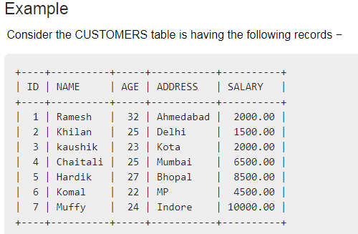

Slide 37
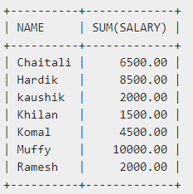
SELECT NAME, SUM(SALARY)
FROM CUSTOMERS
GROUP BY NAME;

Slide 38
Combining the WHERE and the HAVING Clause
Consider the query: we want to count the total number of employees whose salaries exceed $40,000 in each department, but only for departments where more than five employees work.
INCORRECT QUERY:
SELECT Dno, COUNT (*)
FROM EMPLOYEE
WHERE Salary>40000
GROUP BY Dno
HAVING COUNT (*) > 5;

Slide 39
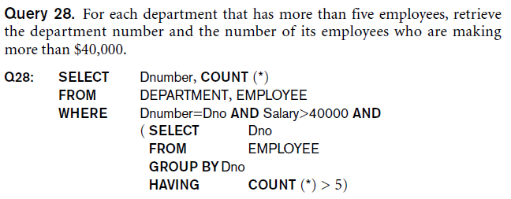
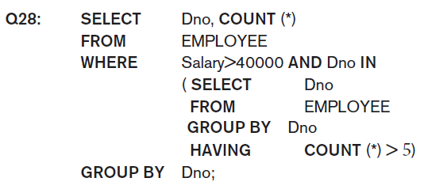
Combining the WHERE and the HAVING Clause (continued)
Correct Specification of the Query:
Note: the WHERE clause applies tuple by tuple whereas HAVING applies to entire group of tuples

Slide 40
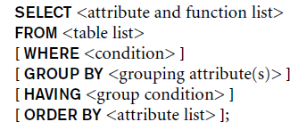
EXPANDED Block Structure of SQL Queries

Slide 41
Specifying Constraints as Assertions and Actions as Triggers
Semantic Constraints: The following are beyond the scope of the EER and relational model
CREATE ASSERTION
Specify additional types of constraints outside scope of built-in relational model constraints
CREATE TRIGGER
Specify automatic actions that database system will perform when certain events and conditions occur

Slide 42
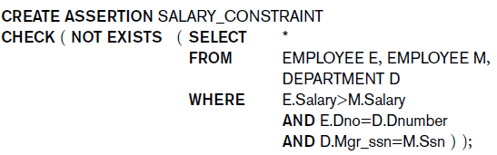
Specifying General Constraints as Assertions in SQL
CREATE ASSERTION
An assertion is a statement in SQL that ensures a certain condition will always exist in the database. Assertions are like column and table constraints, except that they are specified separately from table definitions
Specify a query that selects any tuples that violate the desired condition
Use only in cases where it goes beyond a simple CHECK which applies to individual attributes and domains

Slide 43
Introduction to Triggers in SQL
CREATE TRIGGER statement
Used to monitor the database
Typical trigger has three components which make it a rule for an “active database “
Event(s): These are usually database update operations that are explicitly applied to the database
Condition: determines whether the rule action should be executed
Action: The action is usually a sequence of SQL statements, but it could also be a database transaction or an external program that will be automatically executed

Slide 44
USE OF TRIGGERS
AN EXAMPLE with standard Syntax.(Note : other SQL implementations like PostgreSQL use a different syntax.)
R5:
CREATE TRIGGER SALARY_VIOLATION
BEFORE INSERT OR UPDATE OF Salary, Supervisor_ssn ON EMPLOYEE
FOR EACH ROW
WHEN (NEW.SALARY > ( SELECT Salary FROM EMPLOYEE
WHERE Ssn = NEW. Supervisor_Ssn)) INFORM_SUPERVISOR (NEW.Supervisor.Ssn, New.Ssn)

Slide 45
Views (Virtual Tables) in SQL
Concept of a view in SQL
Single table derived from other tables called the defining tables
Considered to be a virtual table that is not necessarily populated

Slide 46
Specification of Views in SQL
CREATE VIEW command
Give table name, list of attribute names, and a query to specify the contents of the view
In V1, attributes retain the names from base tables. In V2, attributes are assigned names

Slide 47
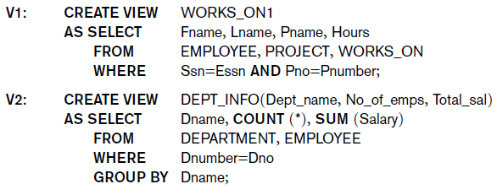

Slide 48
Specification of Views in SQL (cont’d.)
Once a View is defined, SQL queries can use the View relation in the FROM clause
View is always up-to-date
Responsibility of the DBMS and not the user
DROP VIEW command
Dispose of a view

Slide 49
View Implementation, View Update, and Inline Views
Complex problem of efficiently implementing a view for querying
Strategy1: Query modification approach
Compute the view as and when needed. Do not store permanently
Modify view query into a query on underlying base tables
Disadvantage: inefficient for views defined via complex queries that are time-consuming to execute

Slide 50
View Materialization
Strategy 2: View materialization
Physically create a temporary view table when the view is first queried
Keep that table on the assumption that other queries on the view will follow
Requires efficient strategy for automatically updating the view table when the base tables are updated
Incremental update strategy for materialized views
DBMS determines what new tuples must be inserted, deleted, or modified in a materialized view table

Slide 51
View Materialization (contd.)
Multiple ways to handle materialization:
immediate update strategy updates a view as soon as the base tables are changed
lazy update strategy updates the view when needed by a view query
periodic update strategy updates the view periodically (in the latter strategy, a view query may get a result that is not up-to-date). This is commonly used in Banks, Retail store operations, etc.

Slide 52
View Update
Update on a view defined on a single table without any aggregate functions
Can be mapped to an update on underlying base table- possible if the primary key is preserved in the view
Update not permitted on aggregate views. E.g.,
UV2: UPDATE DEPT_INFO
SET Total_sal=100000
WHERE Dname=‘Research’;
cannot be processed because Total_sal is a computed value in the view definition

Slide 53
View Update and Inline Views
View involving joins
Often not possible for DBMS to determine which of the updates is intended
Clause WITH CHECK OPTION
Must be added at the end of the view definition if a view is to be updated to make sure that tuples being updated stay in the view
In-line view
Defined in the FROM clause of an SQL query (e.g., we saw its used in the WITH example)

Slide 54
Views as authorization mechanism
SQL query authorization statements (GRANT and REVOKE) are described in detail in Chapter 30
Views can be used to hide certain attributes or tuples from unauthorized users
E.g., For a user who is only allowed to see employee information for those who work for department 5, he may only access the view DEPT5EMP:
CREATE VIEW DEPT5EMP AS
SELECT *
FROM EMPLOYEE
WHERE Dno = 5;

Slide 55
Schema Change Statements in SQL
Schema evolution commands
DBA may want to change the schema while the database is operational
Does not require recompilation of the database schema

Slide 56
The DROP Command
DROP command
Used to drop named schema elements, such as tables, domains, or constraint
Drop behavior options:
CASCADE and RESTRICT
Example:
DROP SCHEMA COMPANY CASCADE;
This removes the schema and all its elements including tables, views, constraints, etc.

Slide 57
The ALTER table command
Alter table actions include:
Adding or dropping a column (attribute)
Changing a column definition
Adding or dropping table constraints
Example:
ALTER TABLE COMPANY.EMPLOYEE ADD COLUMN Job VARCHAR(12);

Slide 58

Adding and Dropping Constraints
Change constraints specified on a table
Add or drop a named constraint

Slide 59
Dropping Columns, Default Values
To drop a column
Choose either CASCADE or RESTRICT
CASCADE would drop the column from views etc. RESTRICT is possible if no views refer to it.
ALTER TABLE COMPANY.EMPLOYEE DROP COLUMN Address CASCADE;
Default values can be dropped and altered :
ALTER TABLE COMPANY.DEPARTMENT ALTER COLUMN Mgr_ssn DROP DEFAULT;
ALTER TABLE COMPANY.DEPARTMENT ALTER COLUMN Mgr_ssn SET DEFAULT ‘333445555’;

Slide 60
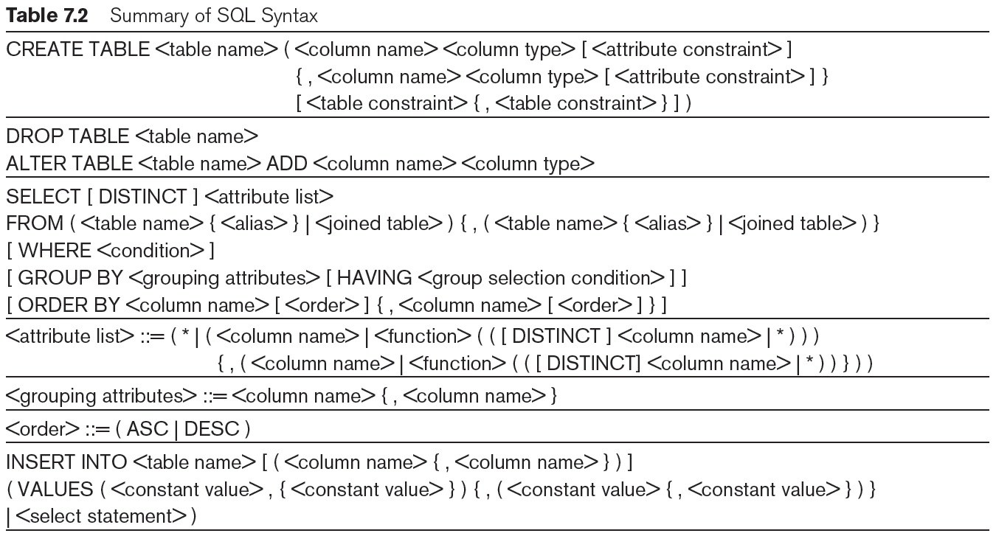
Table 7.2 Summary of SQL Syntax

Slide 61
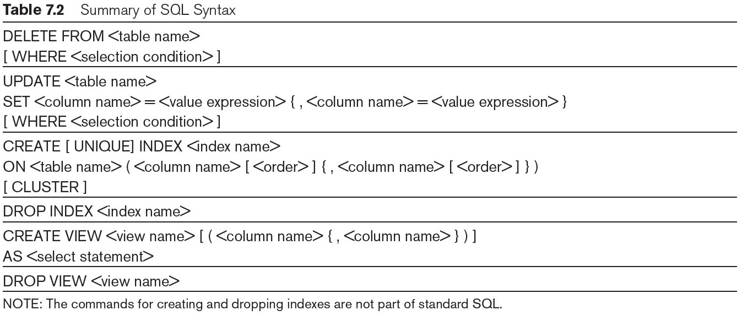
Table 7.2 (continued) Summary of SQL Syntax

